Slide 1

Topic : Smart Examination Hall Mobile Activity Detection and Alert System using STM32
PBCST504 – MICROCONTROLLERS
MICRO PROJECT
Zeroth Review
1

Slide 2
Topic : Smart Examination Hall Mobile Activity Detection and Alert System using STM32
Title:-Smart Examination Hall Mobile Activity Detection and Alert System using STM32
2
Group No:4
Members:
ADORN PRADEEP – JEC24CC007
AISWARYA P S – JEC24CC010
JOYAL GEORGE JOSEPH – JEC24CC039
PRATHISHA V R – JEC24CC050
VISMAYA P S – JEC24CC062
Project Coordinator:
Ms.Sagna L T
Asst. Prof. CSE(CY)
2

Slide 3
Topic : Smart Examination Hall Mobile Activity Detection and Alert System using STM32
DEPARTMENT OF COMPUTER SCIENCE & ENGINEERING
(Cyber Security)
Vision of the Department
To be a globally recognized centre of excellence in Cyber Security education, research and innovation by nurturing ethical professionals , fostering technological advancement through responsible practice and contributing to a secure and sustainable digital society.
3

Slide 4
Topic : Smart Examination Hall Mobile Activity Detection and Alert System using STM32
DEPARTMENT OF COMPUTER SCIENCE & ENGINEERING
(Cyber Security)
Mission of the Department
M1: Excellence in Education : To provide outcome-based and industry-oriented education by integrating core computer science principles with advanced cybersecurity technologies and practices.
M2: Ethics and Professional Responsibility : To cultivate ethical values, integrity, social responsibility, and secure computing practices for protecting digital assets and strengthening cyber trust.
M3: Research, Innovation, and Entrepreneurship : To promote research, innovation, and entrepreneurial thinking for developing sustainable solutions to emerging cybersecurity challenges.
M4: Holistic and Global Development : To enhance leadership, teamwork, lifelong learning, and global competence through industry collaboration, interdisciplinary activities, and community engagement.
4

Slide 5
Topic : Smart Examination Hall Mobile Activity Detection and Alert System using STM32
Programme Educational Objectives (PEOs)
PEO 1: Graduates will apply strong foundations in computer science and cybersecurity to design, develop, and manage secure and reliable computing systems for industry and society.
PEO 2: Graduates will pursue successful careers as professionals, innovators or entrepreneurs engaged in technology development, deployment or engineering system implementation in industry and society and contribute to the economic growth of the country.
PEO 3: Graduates will demonstrate ethical responsibility, leadership, teamwork, and effective communication while adapting to evolving global technological environments through lifelong learning.
5

Slide 6
Topic : Smart Examination Hall Mobile Activity Detection and Alert System using STM32
Programme Outcomes
Engineering Graduates will be able to:
1. Engineering knowledge: Apply the knowledge of mathematics, science, engineering fundamentals, and an engineering specialization to the solution of complex engineering problems.
2. Problem analysis: Identify, formulate, review research literature, and analyze complex engineering problems reaching substantiated conclusions using first principles of mathematics, natural sciences, and engineering sciences.
3. Design/development of solutions: Design solutions for complex engineering problems and design system components or processes that meet the specified needs with appropriate consideration for the public health and safety, and the cultural, societal, and environmental considerations.
4. Conduct investigations of complex problems: Use research-based knowledge and research methods including design of experiments, analysis and interpretation of data, and synthesis of the information to provide valid conclusions.
5. Modern tool usage: Create, select, and apply appropriate techniques, resources, and modern engineering and IT tools including prediction and modeling to complex engineering activities with an understanding of the limitations.
6

Slide 7
Topic : Smart Examination Hall Mobile Activity Detection and Alert System using STM32
6. The engineer and society: Apply reasoning informed by the contextual knowledge to assess societal, health, safety, legal and cultural issues and the consequent responsibilities relevant to the professional engineering practice.
7. Environment and sustainability: Understand the impact of the professional engineering solutions in societal and environmental contexts, and demonstrate the knowledge of, and need for sustainable development.
8. Ethics: Apply ethical principles and commit to professional ethics and responsibilities and norms of the engineering practice.
9. Individual and team work: Function effectively as an individual, and as a member or leader in diverse teams, and in multidisciplinary settings.
10. Communication: Communicate effectively on complex engineering activities with the engineering community and with society at large, such as, being able to comprehend and write effective reports and design documentation, make effective presentations, and give and receive clear instructions.
11. Project management and finance: Demonstrate knowledge and understanding of the engineering and management principles and apply these to one’s own work, as a member and leader in a team, to manage projects and in multidisciplinary environments. 12. Life-long learning: Recognize the need for, and have the preparation and ability to engage in independent and life-long learning in the broadest context of technological change.
7

Slide 8
Topic : Smart Examination Hall Mobile Activity Detection and Alert System using STM32
Programme Specific Outcomes (PSOs)
On the completion of Computer Science & Engineering program, the students will possess:
PSO 1: Apply cyber security principles to mitigate cyber risk and analyze security requirements of an organization.
PSO 2: Develop and deploy secure software and infrastructure using modern tools and industry standards.
PSO 3: Uphold ethical, legal, and societal responsibilities while protecting privacy, data, and digital assets.
8

Slide 9
Topic : Smart Examination Hall Mobile Activity Detection and Alert System using STM32
CONTENTS
Motivation
Introduction
Problem Statement
Proposed Method
Basic Block Diagram
Conclusion
References
9

Slide 10
Motivation
Topic : Smart Examination Hall Mobile Activity Detection and Alert System using STM32
Prevent mobile phone misuse in exams.
Detect active mobile signals instantly.
Improve examination security.
Assist invigilators with real-time alerts.
Low-cost and reliable STM32-based solution.
10

Slide 11
Introduction
Topic : Smart Examination Hall Mobile Activity Detection and Alert System using STM32
Mobile phone misuse affects exam fairness.
Manual monitoring has limitations.
Detects active mobile phone signals.
STM32 processes and generates alerts.
Ensures a secure examination environment.
11

Slide 12
Problem Statement
Topic : Smart Examination Hall Mobile Activity Detection and Alert System using STM32
Mobile phone misuse threatens exam integrity.
Manual monitoring cannot detect all violations.
No instant alert system for active mobile usage.
Need for an automated, real-time detection system.
Ensure a fair and secure examination environment.
12

Slide 13
Proposed Method
Topic : Smart Examination Hall Mobile Activity Detection and Alert System using STM32
Proposed a STM32-based mobile activity detection system.
Use an RF detector to sense active mobile signals.
Process signal data using the STM32 microcontroller.
Generate alerts through buzzer, LED, and display.
Record detection details for examination monitoring.
13

Slide 14
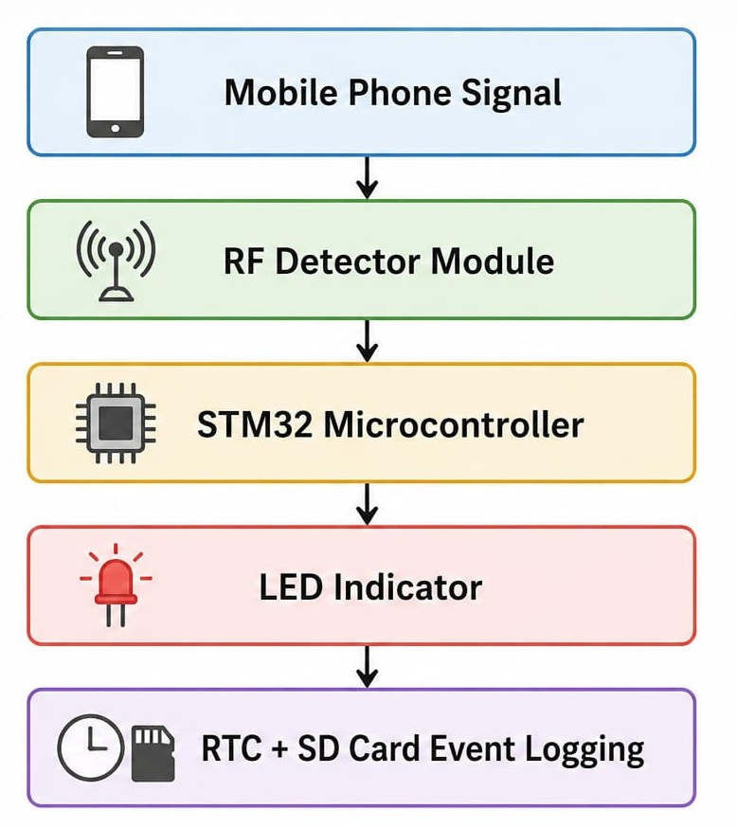
Basic Block Diagram
Topic : Smart Examination Hall Mobile Activity Detection and Alert System using STM32
14

Slide 15
Conclusion
Topic : Smart Examination Hall Mobile Activity Detection and Alert System using STM32
Proposed a STM32-based mobile activity detection system.
Provides real-time alerts for unauthorized mobile usage.
Improves examination security and fairness.
Low-cost and efficient embedded system solution.
Can be enhanced with IoT and advanced monitoring features.
15

Slide 16
References
Topic : Smart Examination Hall Mobile Activity Detection and Alert System using STM32
STM32 Microcontroller Datasheet & Reference Manual.
Embedded Systems Design Books.
RF Signal Detection Concepts.
Sensor Interfacing Resources.
Research Papers on Mobile Detection Systems.
16

